Slide 1


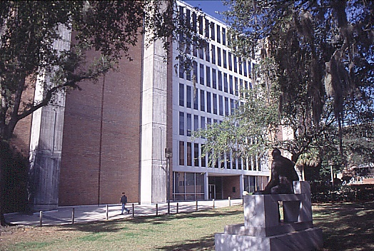
Presenting a Technical Paper
Edwin F. Hilinski
NSF-REU Site: Sunshine Institute for the Interaction of Light with Matter
Department of Chemistry and Biochemistry
Florida State University, Tallahassee, FL 32306-4390
E-mail: efhilinski@fsu.edu
http://www.chem.fsu.edu/hilinski
Adapted from Dale Carnegie Training,
1996 Dale Carnegie & Associates
Acknowledgment - We thank the National Science Foundation Research Experiences for Undergraduates (NSF-REU) Sites program. This material is based upon work supported by the National Science Foundation under Grant No. CHE-2150301.

Slide 2
Overview
1. Tell them what you’re going to tell them.
2. Tell them.
3. Tell them what you’ve told them.

Slide 3
General Tips
1. Do not read your presentation!!
2. Know your audience.
3. Keep eye contact with the audience.
4. Make sure that your visuals are readable.
5. Try not to jiggle the pointer, jingle coins, click retractable
pens, do not remove then replace then remove
then replace… the cap of a dry erase marker, etc.
6. The shorter the talk, the more practice you need.

Slide 4
Organize Your Presentation
1. What is the problem?
2. What do you hypothesize?
3. How did you test your hypothesis (experiment)?
4. What did you observe?
5. What did you conclude?
6. Cite all references to the literature.
If you are not sure, cite a reference; do not plagiarize.

Slide 5
IMRADC
Introduction
Methods
Results
And
Discussion
Conclusions

Slide 6
Slide 1
Title Title Title Title Title
TitleTitle Title Title Title
REU Student Name, In-Lab Mentor 1, In-Lab Mentor 2, and Professor Name*
NSF-REU Site: Sunshine Institute for the Interaction of Light with Matter
Department of Chemistry and Biochemistry, Florida State University
Tallahassee, Florida, 32306-4390
Image(s)
Acknowledgment(s) - We thank the National Science Foundation Research Experiences for Undergraduates (NSF-REU) Sites program. This material is based upon work supported by the National Science Foundation under Grant No. CHE-2150301. [Add additional acknowledgments as needed/desired.]

Slide 7
Introduction
1. The subject—problem and hypothesis
2. Background and justification
3. Objectives of the study

Slide 8
Methods
1. Materials, equipment, and the location of the experiment
2. Methods of sampling
3. Methods of analysis
4. Statistical evaluations

Slide 9
Results and Discussion
1. Synopsis of results
2. Presentation of data
a. Figures
b. Tables
c. Graphs
3. Discussion of significance

Slide 10
Conclusions
1. Summarize your results
2. Put them in context – why they are important
3. Optional – future work to be done and why

Slide 11
Types of Illustrations
1. Tables
2. Graphs – line, bar, pie, 3D
3. Photos

Slide 12
Make It Simple
1. Tables should be clear
a. Put like items in columns
b. Round off numbers; significant figures; align decimals
2. Figures
a. Limit the number of curves or bars on graph
b. x is the independent variable; y is dependent
c. Avoid wasted space, but do not overcrowd
d. Label axes carefully

Slide 13
Use of Color in Slides
1. Background – subdued or neutral colors
2. Highlighting points – bright or contrasting colors
3. Check colors on projection screen
4. Coordinate colors for presentation
5. Implement the KISS principle

Slide 14
Posters
1. Brief and clearly organized
2. Simple with an obvious central point
a. Short text / paragraphs (<20 lines)
3. Easy to read from 1 to 2 meters away
4. Attractive and aesthetically pleasing
a. Mix visual imagery with text
b. Use color appropriately
[More details about posters will be given in separate
documents: PosterPresentations_Arial_240607a.pptx ;
PosterPresentations_Arial_240607a.pdf ;
Poster_Template_240607a.pptx .]

