Slide 2
Chapter 11
Intermolecular forces?
Ch 11
Page 467

Slide 3
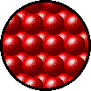
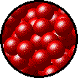
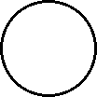
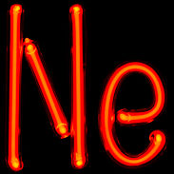
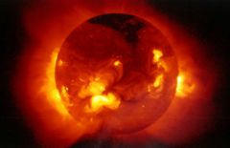
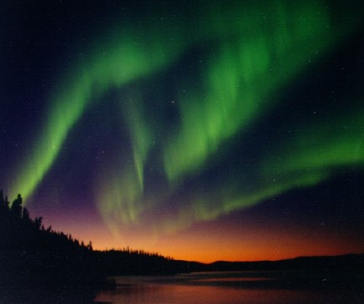
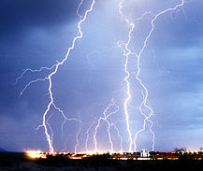
STATES OF MATTER
Plasma- Electrically charged particles in a gaseous state.
We will focus on solids liquids and gasses.

Slide 4
States of Matter
Ch 11.1
Page 468

Slide 5
Comparison of Solids, Liquids, and Gases
The density of gases is much less than that of solids or liquids.
Densities (g/mL) | Solid | Liquid | Gas
H₂O | 0.917 | 0.998 | 0.000588
CCl₄ | 1.70 | 1.59 | 0.00503
Gas molecules must be very far apart compared to liquids and solids.

Slide 6
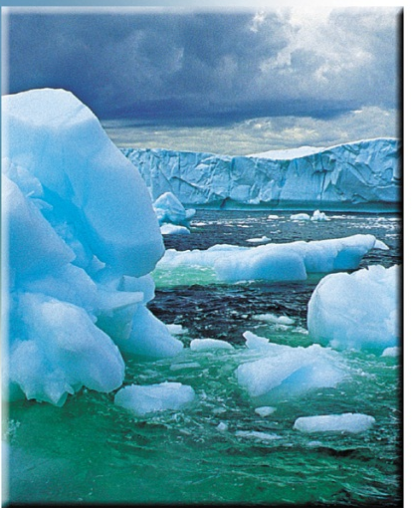
States of Matter
Solid - ice
Liquid - water
A phase is a homogeneous part of the system in contact with other parts of the system but separated from them by a “well-defined” boundary.
A phase is a part of a system with a distinct set of physical properties. Crossing

Slide 7
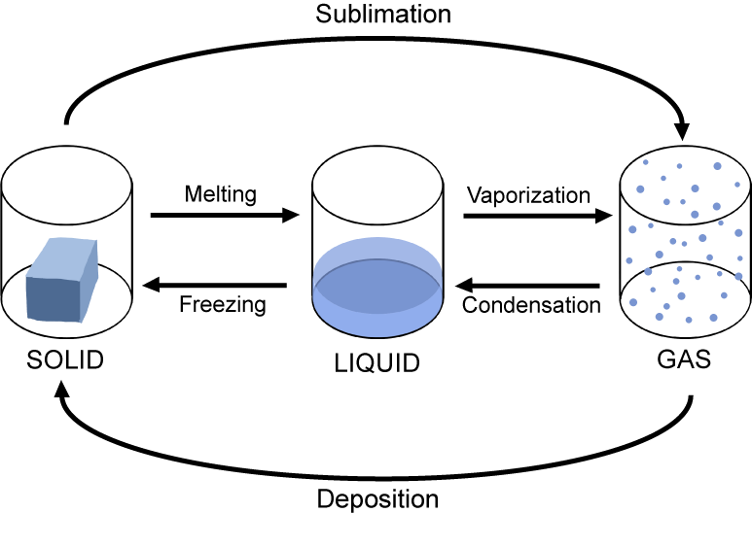
States of Matter
We call the transitions between different states of matter phase changes
What dictates the current state of the system?
or
Why is there a change between states?

Slide 8
Phase Changes
heat is released
condensation
freezing
gas
liquid
solid
cool
cool
heat
heat
evaporation
melting
increasing temperature
heat is absorbed
Energy needed to break intermolecular interactions.

Slide 9
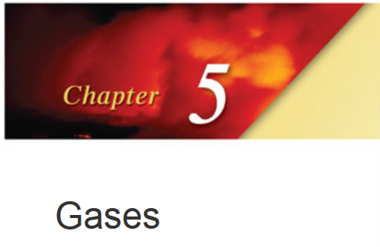
Ideal Gas Equation
P = pressure
V = volume
n = number of moles
R = gas constant
T = temperature
PV = nRT
Assumptions:
Gas atoms/molecules are perfect spheres (spherical cow!)
Size of atoms/molecules are negligibly small
There are no intermolecular/atom forces
Ok assumptions for gasses, does not work for solids and liquids.

Slide 10
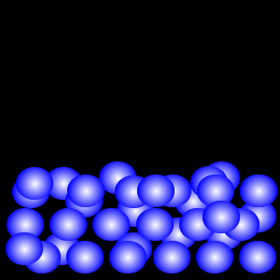
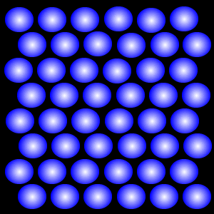
Liquids and Solids
Not all solids and liquids are equal:
Viscosity, conductivity, surface tension, volume, density, melting point, boiling point, hardness, color, flexibility, cost
Variables:
Size and shape of the molecules/atoms
The intramolecular forces

Slide 11
Intramoelcular vs Intermolecular
Intramolecular forces
exist within each molecule
influence the chemical properties of the substance
ionic, covalent, and metallic bonds
Intermolecular forces
exist between the molecules
influence the physical properties of the substance
Responsible for the state of the system:
gas, liquid, solid.
Ch 11.2
Page 469

Slide 12
Intramolecular vs. Intermolecular Forces
Intramolecular forces:
Ionic bonds (400-4000 kJ/mol)
Covalent bonds (150-1100 kJ/mol)
Metallic bonds (75-1000 kJ/mol)
Intermolecular forces:
0.05-100 kJ/mol
much weaker
Example
41 kJ to vaporize 1 mole of water (inter)
930 kJ to break all O-H bonds in 1 mole of water (intra)

Slide 13
Liquids and Solid
Why do some solids dissolve in water but others do not?
Why are some substances gases at room temperature, but others are liquid or solid?
What gives metals the ability to conduct electricity, what makes non-metals brittle?
Intermolecular forces

Slide 14
Flavors of Intermolecular Forces
dipole-dipole
ion-dipole
Induced/instantaneous dipole:
ion-induced dipole
dipole-induced dipole
instantaneous dipole-induced dipole
hydrogen bonding
Ch 11.2
Page 470

Slide 15
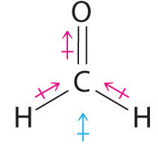
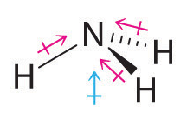
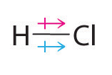
Dipole-Dipole Forces
Molecular dipole-neutral molecule with a positive and negative electron distribution.
Bond Dipole
Molecular Dipole
Molecules that have permanent dipoles are attracted to each other via dipole-dipole interactions.
The positive end of one is attracted to the negative end of the other and vice-versa. Larger dipole = stronger attraction.
Ch 11.2
Page 469

Slide 16
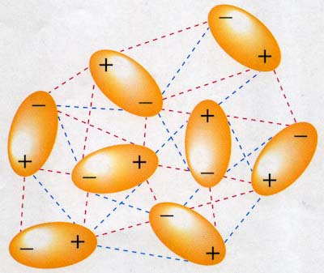
Dipole-Dipole Forces
In solution:
Both attractive and repulsive forces.
Typical energy range: 5-25 kJ/mol.

Slide 17
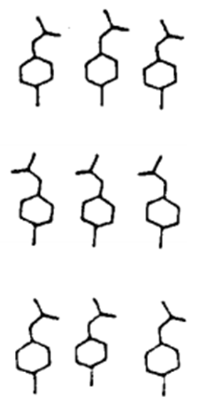
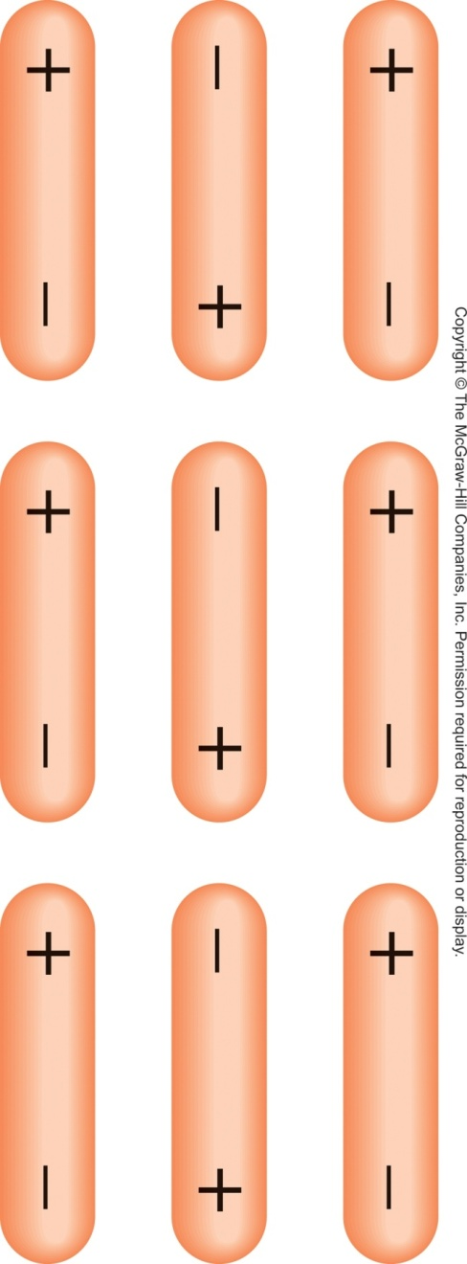
Dipole-Dipole Forces
In solids:
p-chloroacetanilide-
Pyroelectricity
Piezoelectricity
All dipoles cancel.
Dipoles sum.

Slide 18
Flavors of Intermolecular Forces
dipole-dipole
ion-dipole
Induced/instantaneous dipole:
ion-induced dipole
dipole-induced dipole
instantaneous dipole-induced dipole
hydrogen bonding
Ch 11.2
Page 470

Slide 19
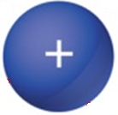
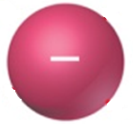
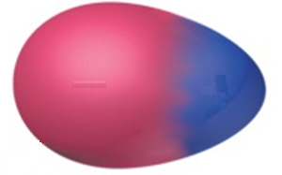
Ion-Dipole Forces
Ion
Dipole (polar)
The ion is attracted to the opposite charge on the polar molecule.
Ch 11.2
Page 470

Slide 20
Flavors of Intermolecular Forces
dipole-dipole
ion-dipole
Induced/instantaneous dipole:
ion-induced dipole
dipole-induced dipole
instantaneous dipole-induced dipole
hydrogen bonding
Ch 11.2
Page 470

Slide 21
Dipole-Dipole Forces
In solution:
Both attractive and repulsive forces.
Typical energy range: 5-25 kJ/mol.

Slide 22
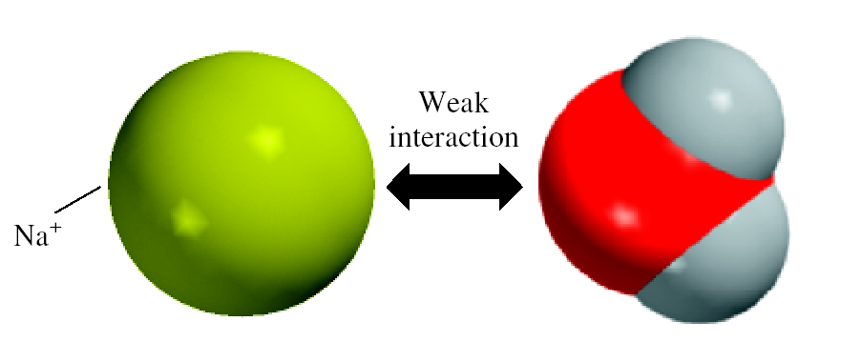
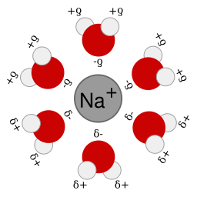
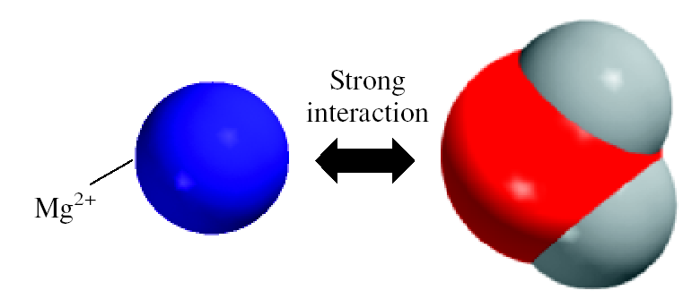
Ion-Dipole Forces
Plays a major role when an ionic compound dissolves in water.
Typical energy range: 40-600 kJ/mol.
Dependent on: ion size/charge and dipole strength

Slide 23
Flavors of Intermolecular Forces
dipole-dipole
ion-dipole
Induced/instantaneous dipole:
ion-induced dipole
dipole-induced dipole
instantaneous dipole-induced dipole
hydrogen bonding
Ch 11.2
Page 470

Slide 24
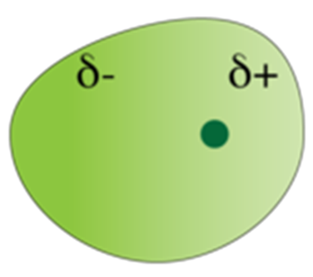
Instantaneous or Induced Dipole
Fluctuations of electron density create an instantaneous dipole (or induced dipole) at an arbitrary moment in time.
non-polar
molecule/atom
instantaneous dipole
or
induced dipole
This property of the electron cloud to be distorted is called polarizability

Slide 25
Polarizability Trends
Polarizability increases down the table:
bigger electron cloud = easier to distort
Polarizability decreases from left to right across the table
more positive nuclear charge = less flexible electron cloud
Cations are less polarizable than their neutral parent atoms because they are smaller; anions are more polarizable because they are larger.
“Longer” molecules are more easily polarized than more compact molecules.
more easily polarized
less easily polarized

Slide 26
Non-polar Molecules
non-polar
molecule/atom
instantaneous dipole
or
induced dipole
Non-polar Intermolecular Interactions:
ion-induced dipole
dipole-induced dipole
instantaneous dipole-induced dipole

Slide 27
Induced Dipole Forces
Ion-induced dipole: 3-15 kJ/mol
Dipole-induced dipole: 2-10 kJ/mol
+ cation
+ anion
Neutral atom

Slide 28
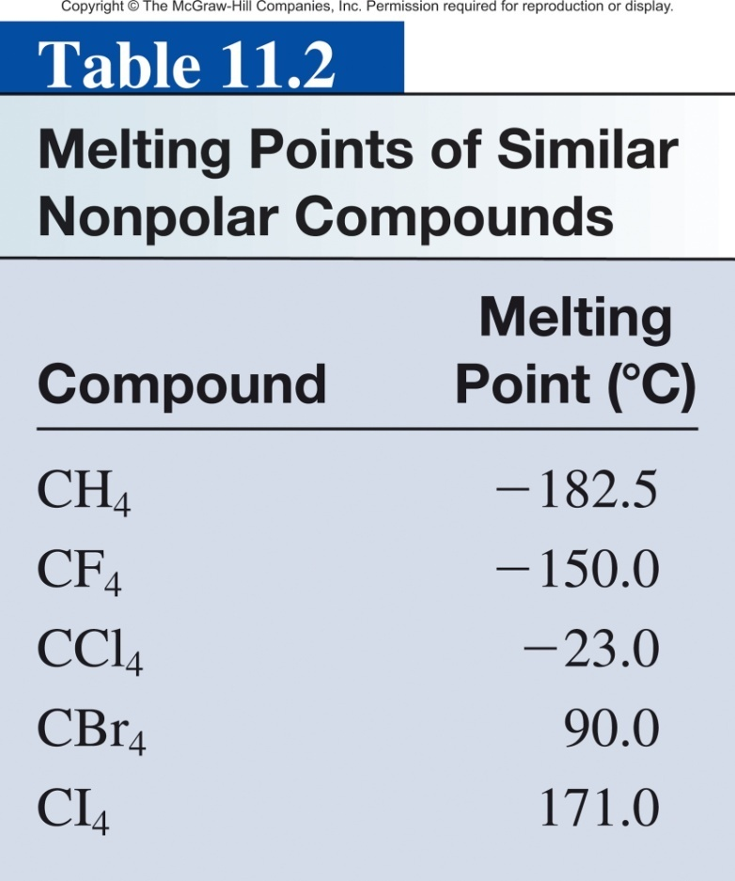
Instantaneous dipole-induced dipole
A.K.A. London Dispersion Forces
A.K.A. Dispersion Forces
Dispersion forces usually increase with molar mass.
instantaneous dipole
induced dipole
Interaction between non-polar atoms and/or molecules.

Slide 29
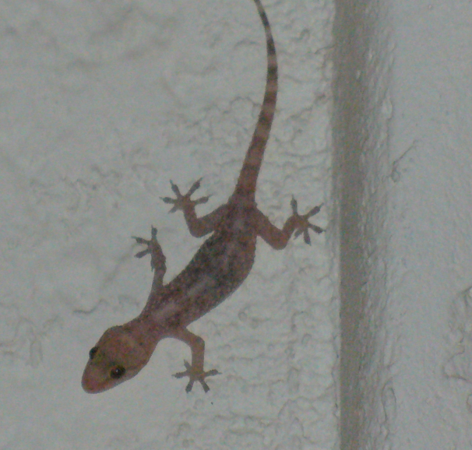
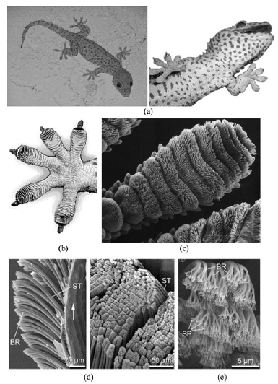
Gecko Wall Walking
van der Waals force:
dipole-dipole
dipole-induced dipole
London dispersion

Slide 30
What type(s) of intermolecular forces exist between the following pairs?
HBr and H₂S
Cl₂ and CBr₄
I₂ and NO₃⁻
NH₃ and C₆H₆
Hint: First classify the species into three categories: ionic, polar (possessing a dipole moment), and nonpolar.

Slide 31
Solutions
Both HBr and H₂S are polar molecules. Therefore, the intermolecular forces present are dipole-dipole forces.
Both Cl₂ and CBr₄ are nonpolar, so there are only dispersion forces between these molecules.
(c) I₂ is nonpolar, so the forces between it and NO₃⁻ (ion) are ion-induced dipole forces.
(d) NH₃ is polar, and C₆H₆ is nonpolar. The forces are dipole-induced dipole forces.

Slide 32
Flavors of Intermolecular Forces
dipole-dipole
ion-dipole
Induced/instantaneous dipole:
ion-induced dipole
dipole-induced dipole
instantaneous dipole-induced dipole
hydrogen bonding
Ch 11.2
Page 470

Slide 33
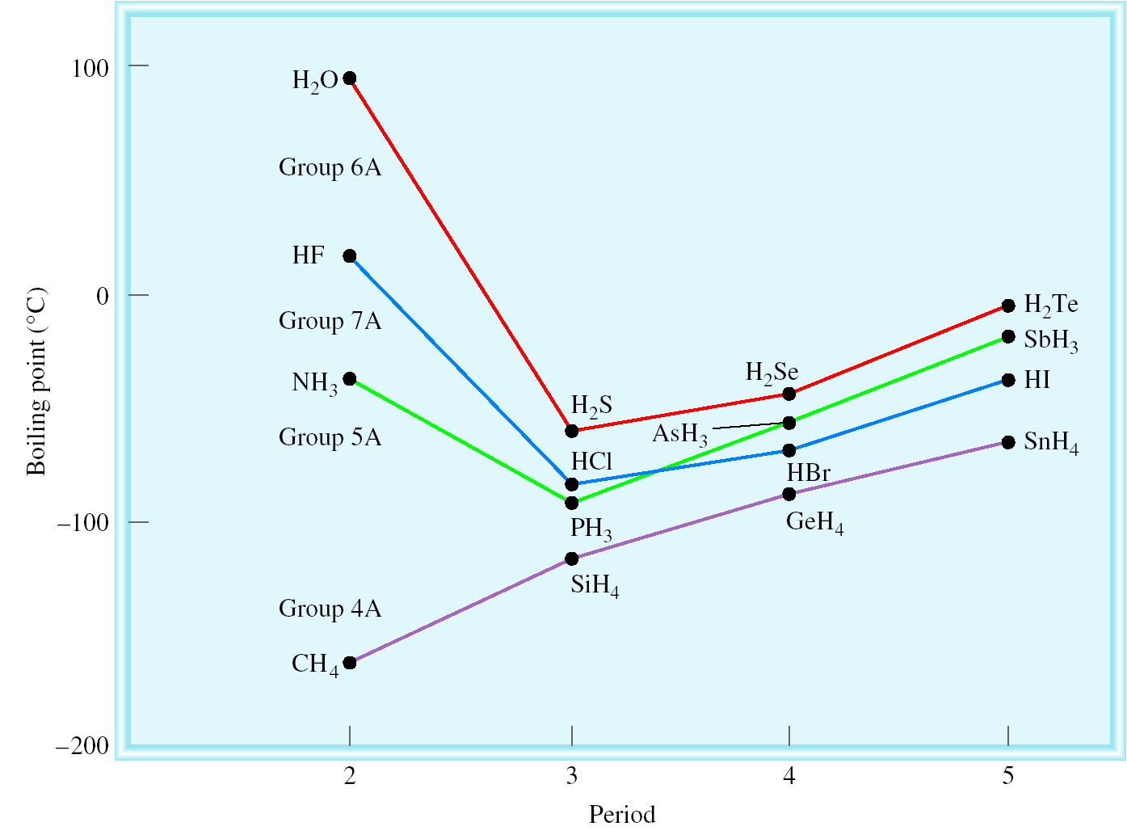
Hydrogen Bonding
Anomalous trends in boiling points and other properties.
Decreasing molar mass
Decreasing boiling point
Ch 11.2
Page 473

Slide 34
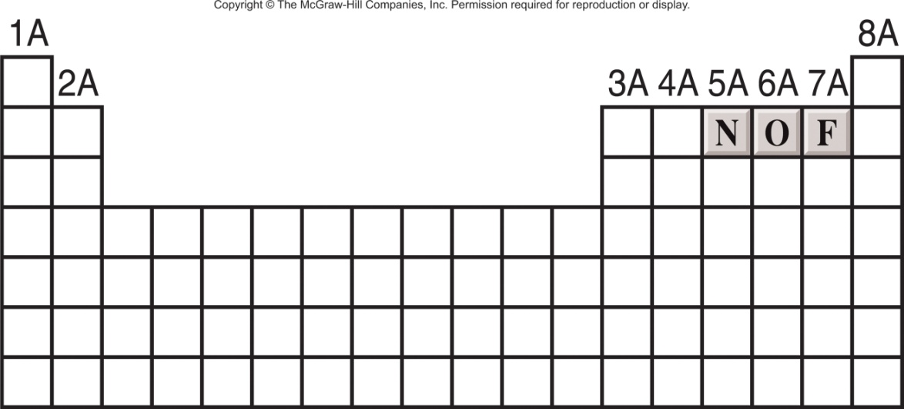
Hydrogen Bonding
A hydrogen bond is a special dipole-dipole interaction between the hydrogen atom in a polar N-H, O-H, or F-H bond and a lone pair on O, N, or F atom.
A
H
…
B
or
A
H
…
A
Where A & B are N, O, or F
Typical energy:
10-40 kJ/mol.
Hydrogen bonding molecules have:
A strong permanent dipole
(electronegative elements)
A hydrogen atom
An atom with lone pair electrons (N, F, O)

Slide 35
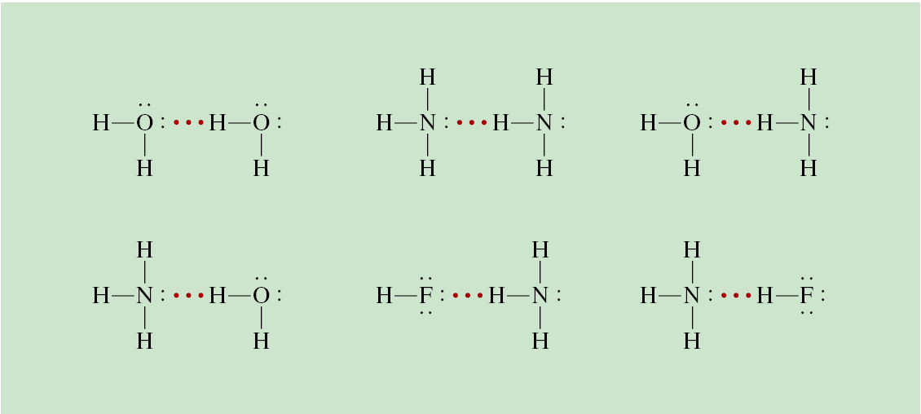
Hydrogen Bonding
These are forces between polar molecules that contain an H atom bonded to a small, highly electronegative atom with lone electron pair(s): N, O, F
N(CH₃)₃
N(CH₃)₄⁺
Can Hydrogen bond
Cannot Hydrogen bond

Slide 36
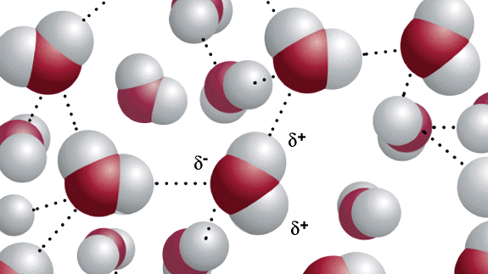
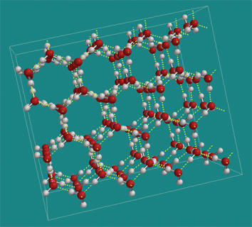
Hydrogen Bonding in H₂O
Liquid
(water)
Solid
(ice)

Slide 37
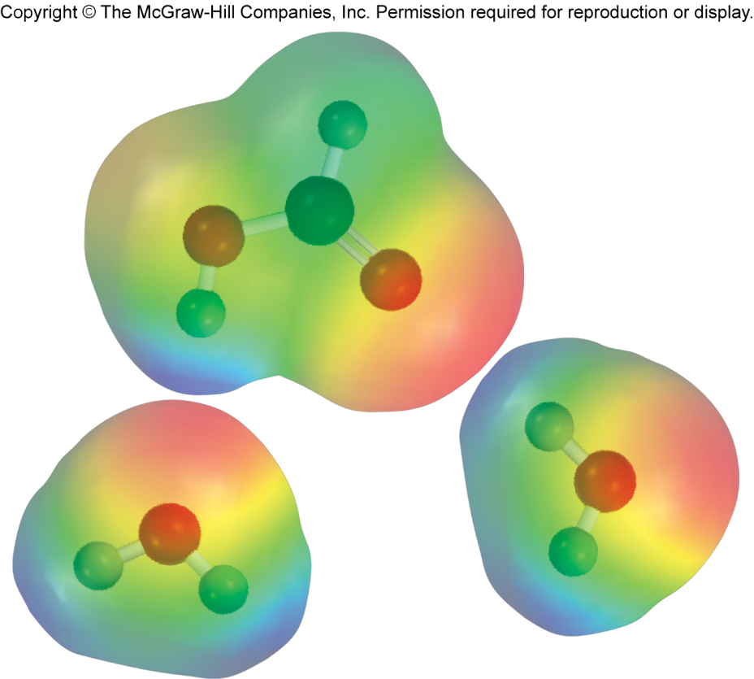
Hydrogen Bonding
Note: that some molecules like HCOOH (formic acid) and others can form hydrogen bonds in multiple ways.

Slide 38
Which of the following can form hydrogen bonds with water?
CH₃OCH₃
CH₄
F₂
HCOOH
Na⁺

Slide 39
Strategy A species can form hydrogen bonds with water if it contains one of the three electronegative elements (F, O, or N) and has a lone pair or it has a H atom bonded to one of these three elements.
Solution There are no electronegative elements (F, O, or N) in either CH₄ or Na⁺. Therefore, only CH₃OCH₃, F₂, and HCOOH can form hydrogen bonds with water.

Slide 40
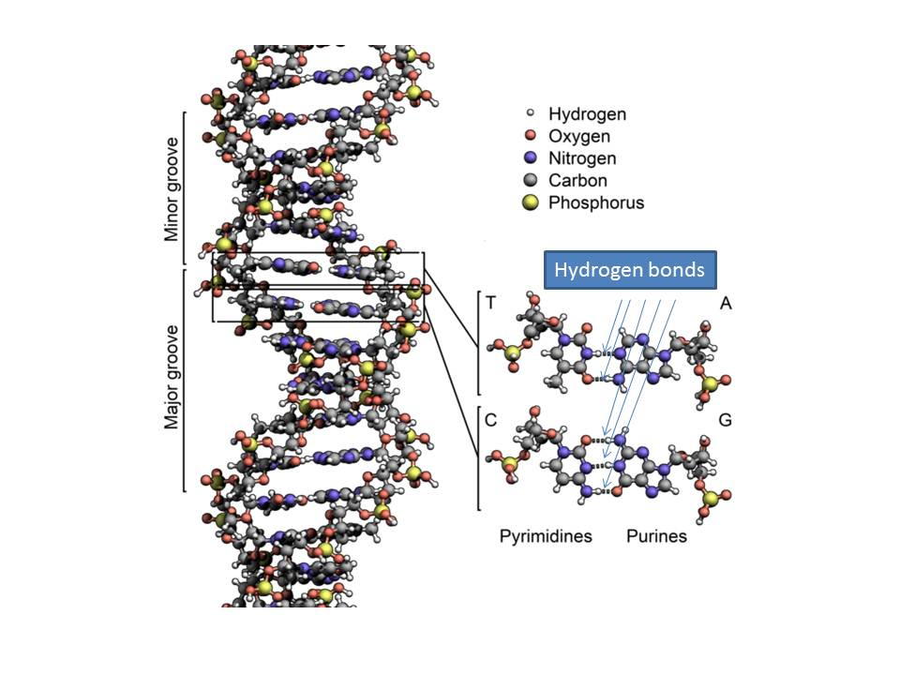
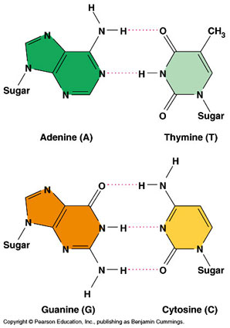
Why does hydrogen bonding matter?
Strong enough to hold a helix!
Weak enough for replication!

Slide 41
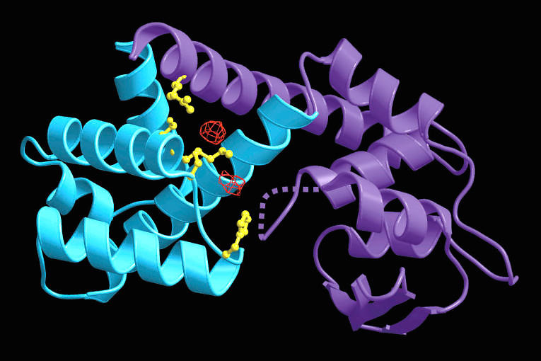
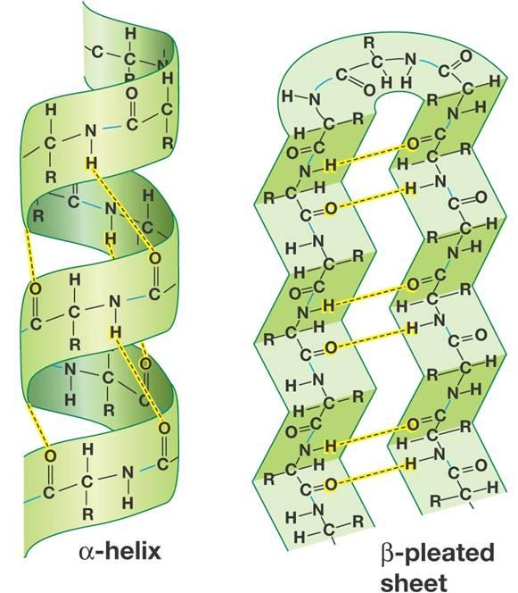
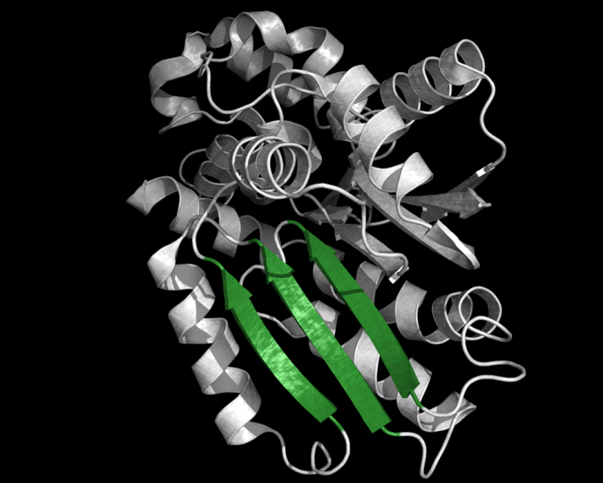
Why does hydrogen bonding matter?
Protein Structure

Slide 42
Flavors of Intermolecular Forces
dipole-dipole
ion-dipole
Induced/instantaneous dipole:
ion-induced dipole
dipole-induced dipole
instantaneous dipole-induced dipole
hydrogen bonding
Ch 11.2
Page 470

Slide 43
Intermolecular Forces

Slide 44
Strength of Intermolecular Forces
dipole-dipole (5-25 kJ/mol)
ion-dipole (40-600 kJ/mol)
Induced/instantaneous dipole:
ion-induced dipole (3-15 kJ/mol)
dipole-induced dipole (2-10 kJ/mol)
instantaneous dipole-induced dipole (<2 kJ/mol)
hydrogen bonding (10-40 kJ/mol)
Intermolecular Forces general correlate with boiling point.
greater force = higher boiling point

Slide 45
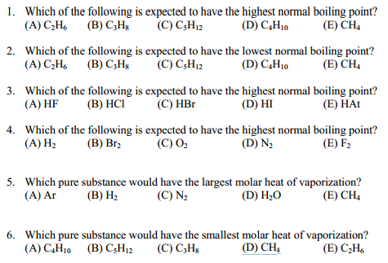
Strength of Intermolecular Forces

Slide 46
Properties of liquids
Surface Tension
intermolecular forces at liquid-air interface
Capillary Action
competition between intermolecular forces
Viscosity
strength of intermolecular forces
Ch 11.3
Page 470

Slide 47
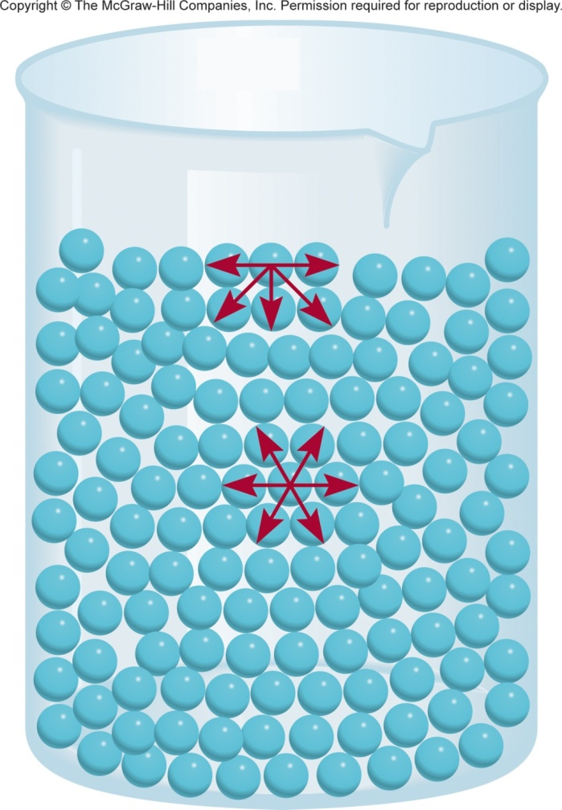
Surface Tension
Surface tension is the amount of energy required to stretch or increase the surface of a liquid by a unit area.
The surface molecules have higher energy than the interior molecules.
That’s why liquids tend to minimize their surface and form droplets.
Surface tension is a measure of attractive forces acting at the surface of a liquid.
The molecules at the surface are attracted unevenly.
Ch 11.3
Page 475

Slide 48
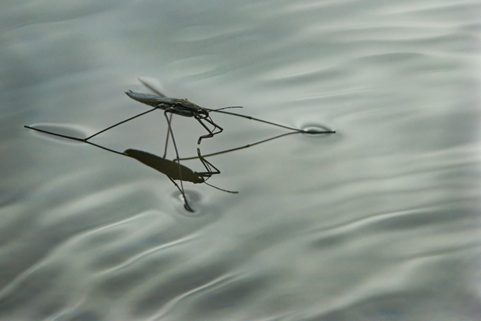
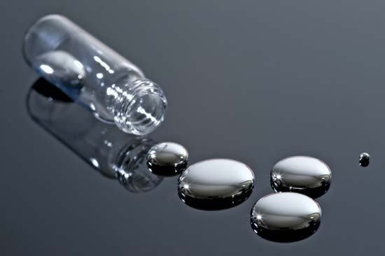
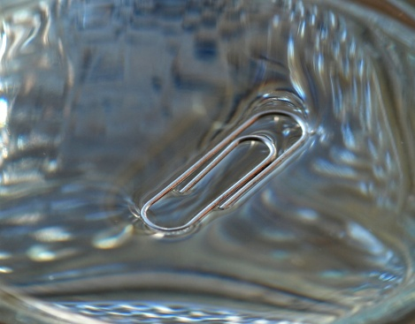
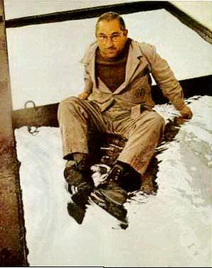
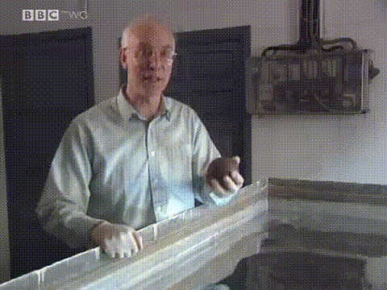
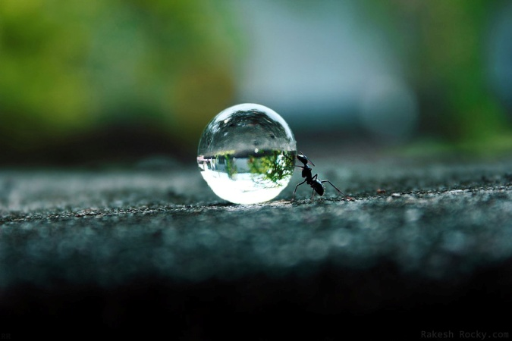
Surface Tension
Water
Mercury
Not really surface tension but still cool.

Slide 49
Surface Tension
Stronger intermolecular forces usually result in the greater surface tension.
Liquid | Surface Tension (J/m²) at 20°C | Boiling Point, °C
Ethanol | 2.3×10^{–2} | 78.4°C
Butanol | 2.5×10^{–2} | 118°C
Water | 7.3×10^{–2} | 100°C
Mercury | 48×10^{–2} | 630°C

Slide 50
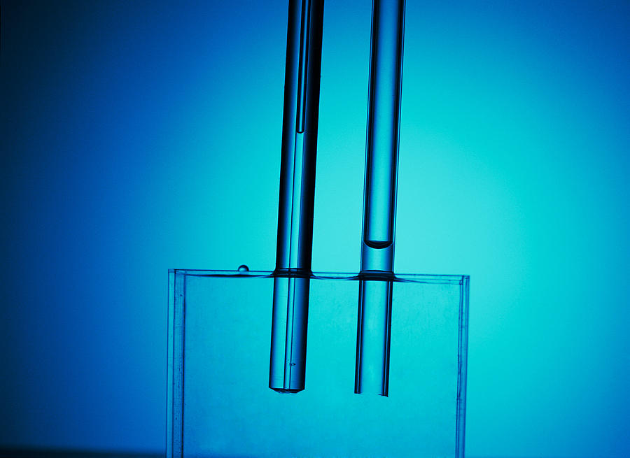
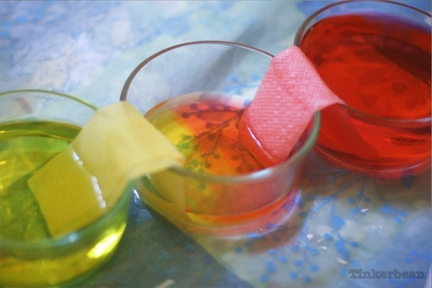
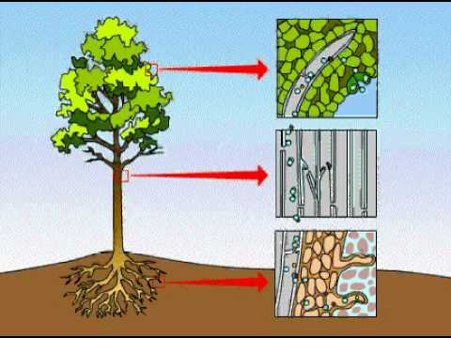
Capillary Action
Capillary action (sometimes capillarity, capillary motion, or wicking) is the ability of a liquid to flow in narrow spaces without the assistance of, and in opposition to, external forces like gravity.
Ch 11.3
Page 475

Slide 51
Forces Involved in the Capillary Action
Cohesive forces are the forces that hold liquids together (intermolecular forces).
Adhesive forces are the forces between a liquid and another surface (intermolecular forces).
Capillary rise implies that:
Adhesive forces > cohesive forces
Capillary fall implies that the:
Cohesive forces > adhesive forces

Slide 52
Capillary Action
Capillary action is the ability of a liquid to rise (or fall) in a glass tube or other container
Capillary rise.
Capillary fall.
Water
Mercury
Adhesive forces > cohesive forces
Adhesive forces < cohesive forces

Slide 53
Capillary Action
Water
Concave meniscus
Mercury:
Convex meniscus
adhesive forces > cohesive forces
adhesive forces < cohesive forces

Slide 54
Capillary Action
Smaller diameter, higher the climb.
Volume (gravity) vs. Surface area (adhesion)

Slide 55
Viscosity
Viscosity is the resistance of a liquid to flow.
For example, water is less viscous than syrup or honey.
It is related to the ease with which molecules can move past each other.
Decreases with increasing temperature.
Viscosity depends on intermolecular forces and on the shape of molecules.
Liquids with small spherical molecules are less viscous than liquids with long molecules that can become entangled and pour slowly.
Ch 11.3
Page 470

Slide 56
Viscosity
Low Viscosity
High Viscosity
Strong intermolecular forces
= higher viscosity

Slide 57
Viscosity
Pitch Drop “Experiment”
Started in 1927
by Professor Thomas Parnell
University of Queensland in Australia
Worlds longest experiment
9th drop fell April 17th, 2014
https://www.youtube.com/watch?v=vZ5Vm4vABH4
http://theninthwatch.com/

Slide 58
Chapter 11
Intermolecular forces according to Google Images:
Ch 11
Page 467

